Slide 1
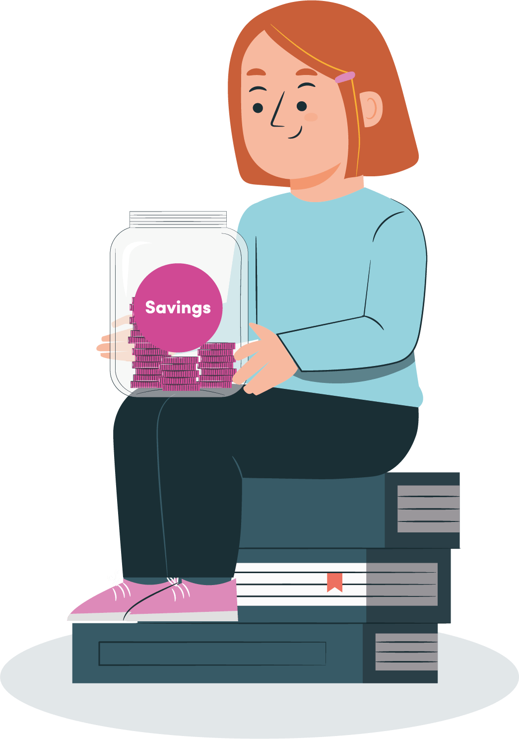
Thankfulness, Generosity and Maths
Assembly – maths week 2023

Slide 2

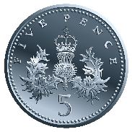
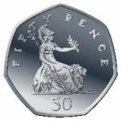
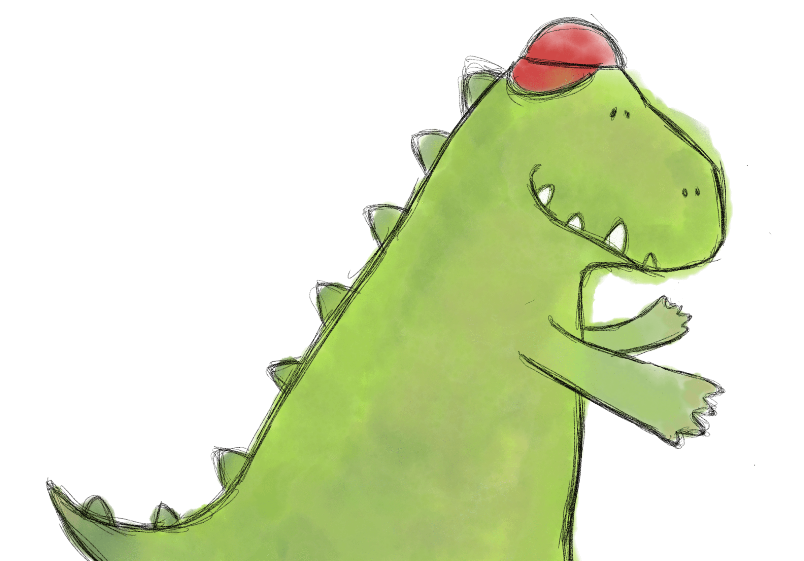
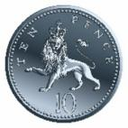
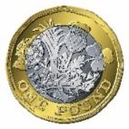
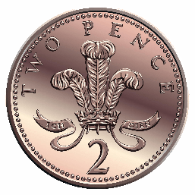

Thankfulness, Generosity and Maths
What coins are these?
How much is here?
Notes:
Intro – as all arrive
Counting some coins – image on screen but be counting physical coins – or have yourself on video counting them?
Acting wondering what you could spend them on

Slide 3
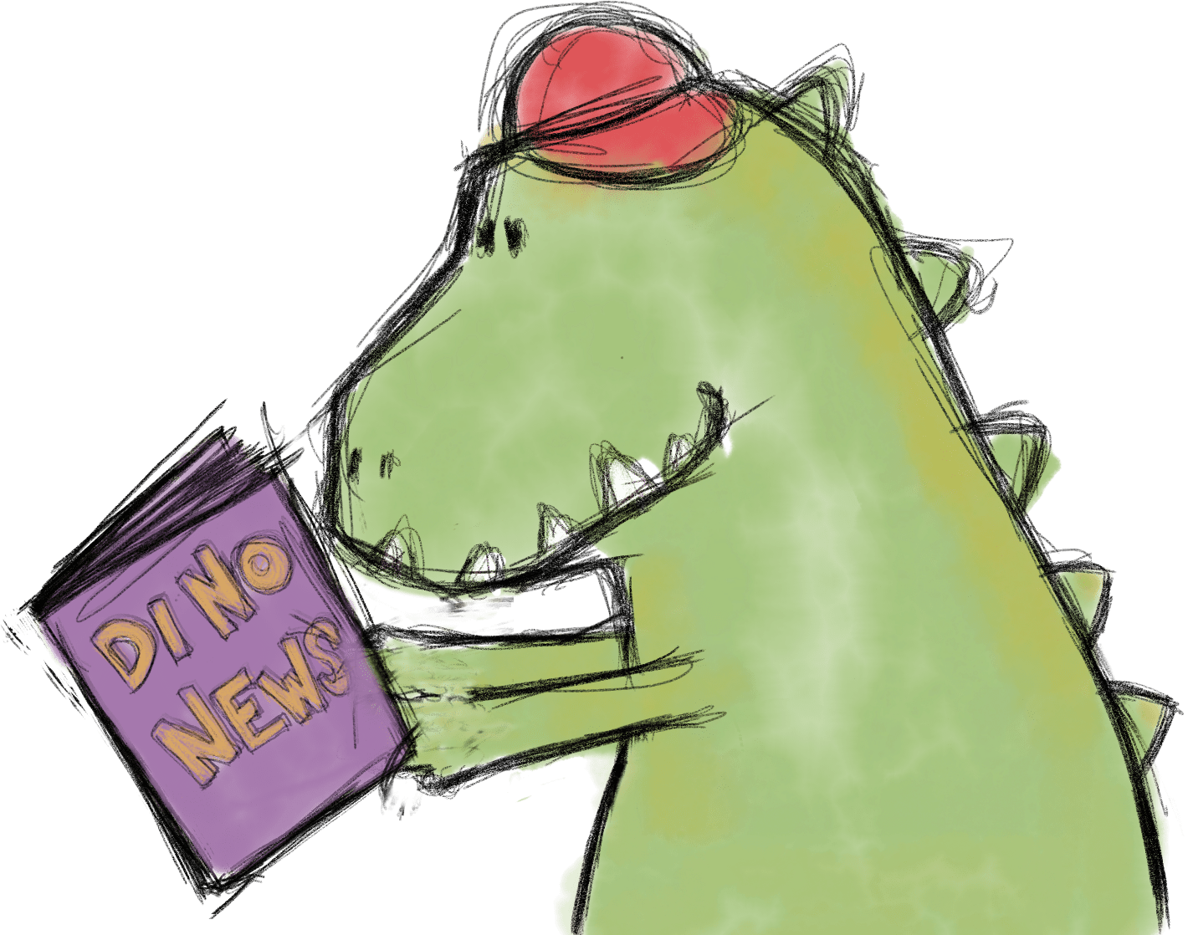
Thankfulness, Generosity and Maths
Welcome
Does anyone know what we mean by generosity?
Does anyone know what we mean by thankfulness?
Does anyone know what we mean my mathematics! (or maths)

Slide 4
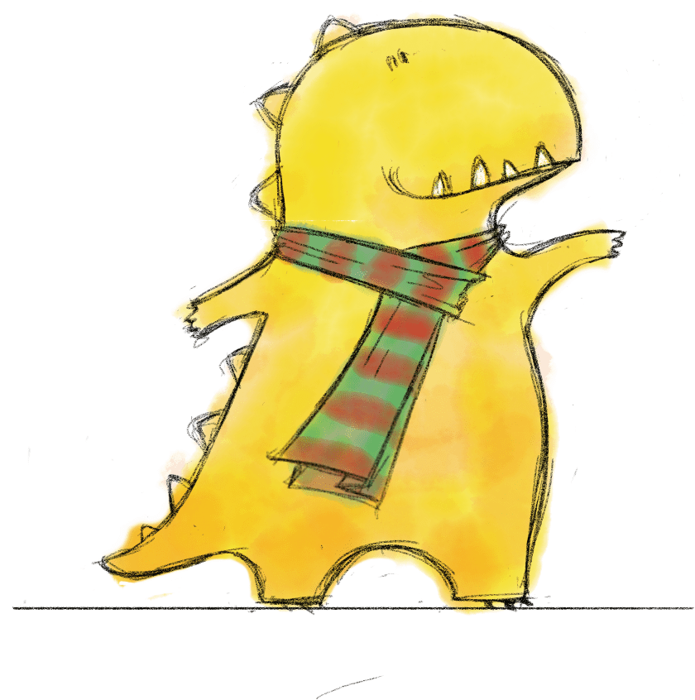
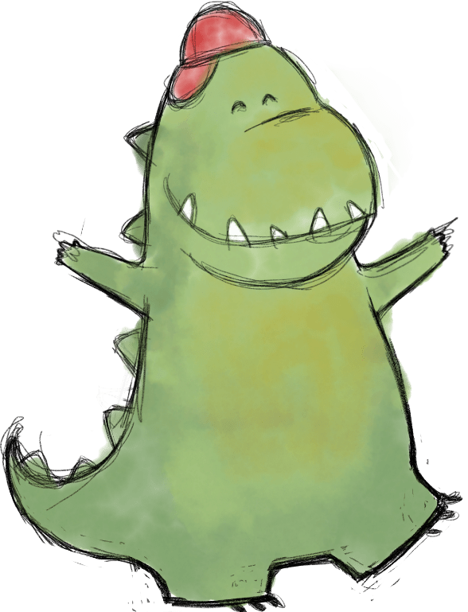
Thankfulness, Generosity and Maths
Listen to the Story

Slide 5
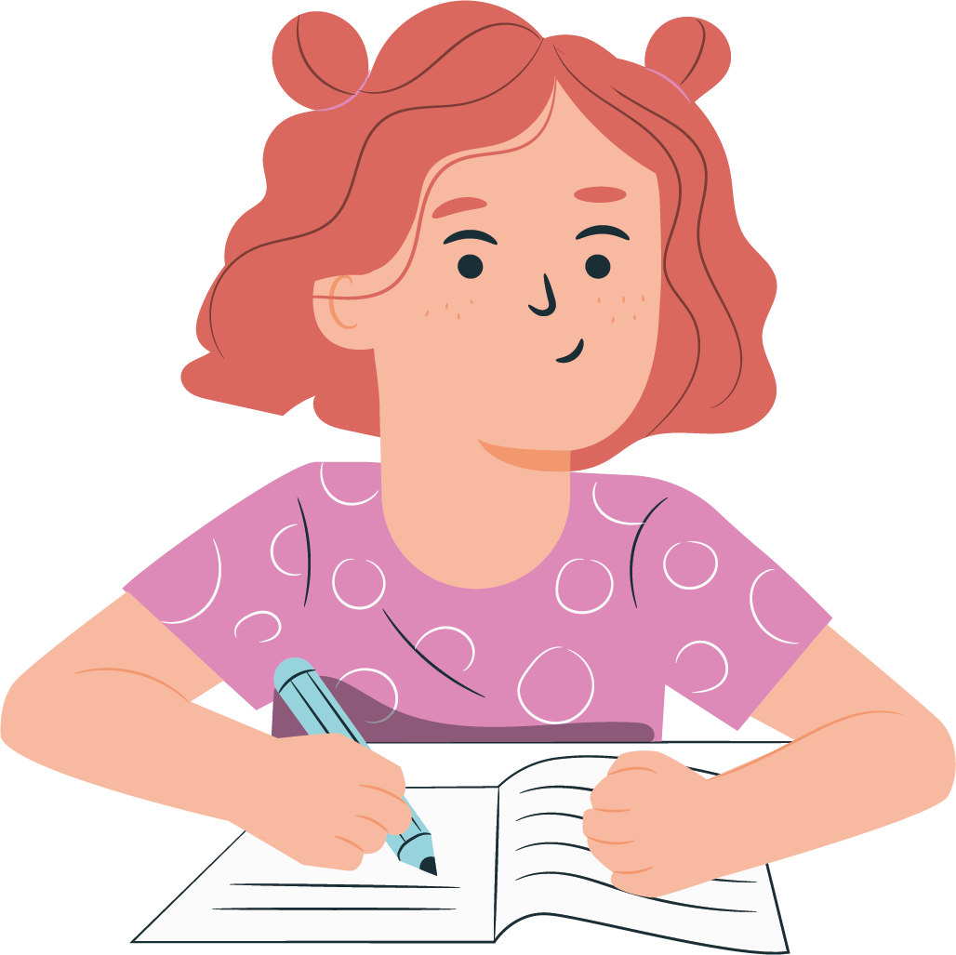
How well were you listening?

Slide 6
Thankfulness, Generosity and Maths
Which bits of this story showed:
Generosity
Thankfulness
Maths

Slide 7
Thankfulness, Generosity and Maths
Reflecting:
Do you think Steg was making wise choices?
Should Milo have reminded his friend to say thank you for the money?
How could Steg show gratitude for the money?

Slide 8
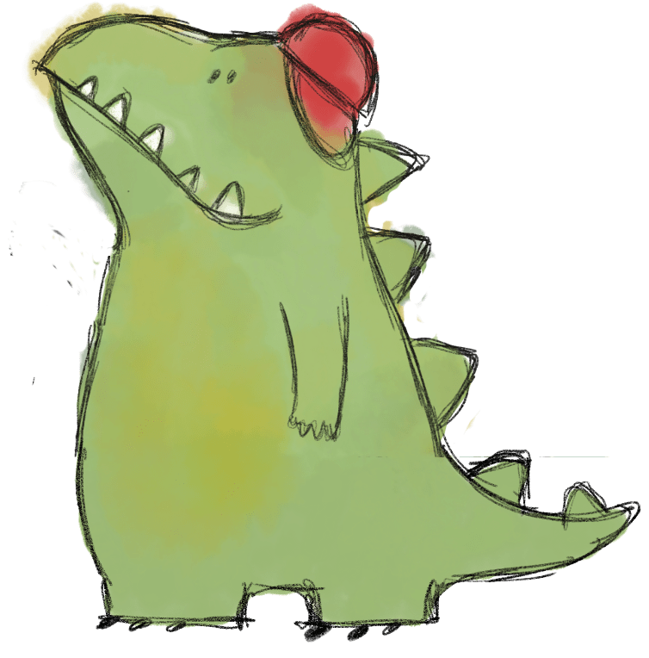
Thankfulness, Generosity and Maths
Responding:
If you like, you could say this short prayer(faith)/thought(secular) with the children.
(Dear Lord God)
Thank you for the good things we have and for surprises and special gifts.
Please help us to think carefully about the things we can spend our money on.
Please help us to be really thankful to the people who share things with us.
(Amen.)

Slide 9
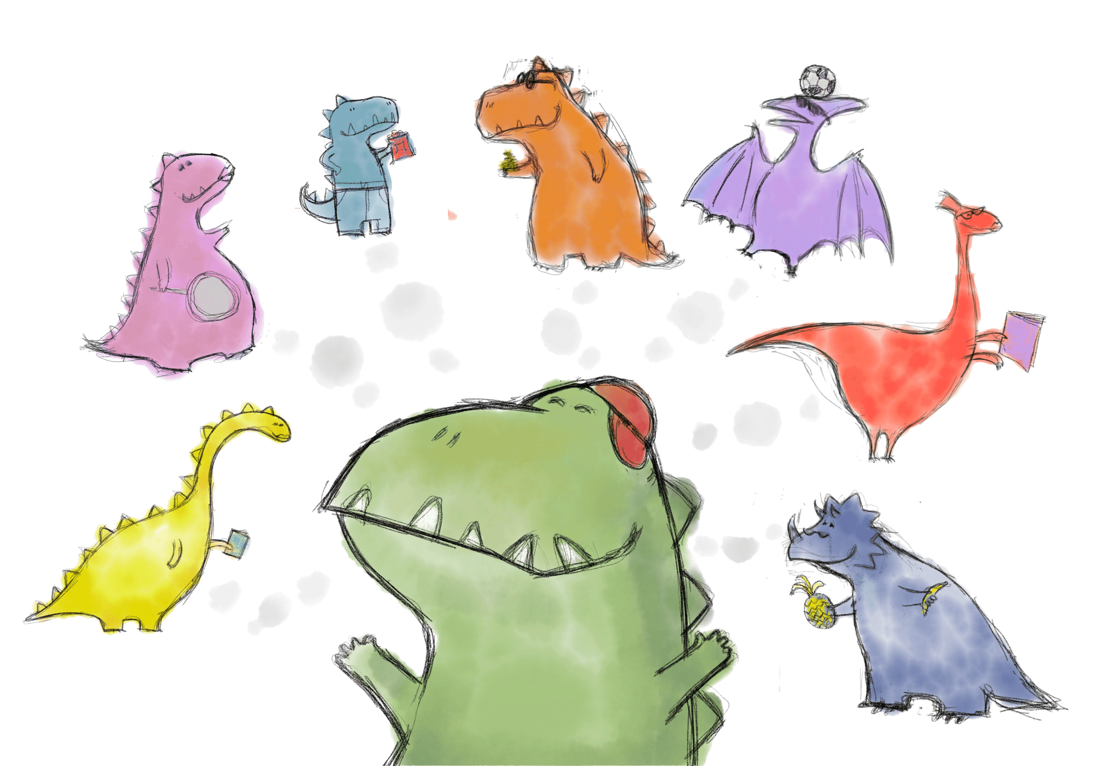
Thankfulness, Generosity and Maths
Sending (faith based):
As we remember our thankfulness to God,
May God the Father encourage us,
God the Son befriend us,
And God the Holy Spirit support us.
Amen

Slide 10
Thankfulness, Generosity and Maths
Sending (secular):
Let us leave today feeling Thankful for everything we have and the people around us who are kind and share with us.

Slide 11
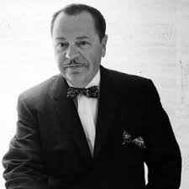
Thought For the Day
If you are really thankful, what do you do? You share!
W. Clement Stone – businessman and author.

