Slide 1
THE POWER OF 2

Slide 2
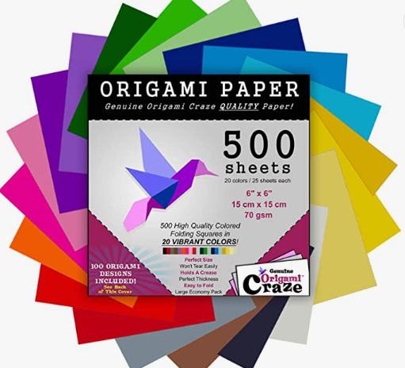
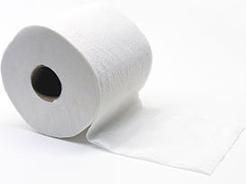
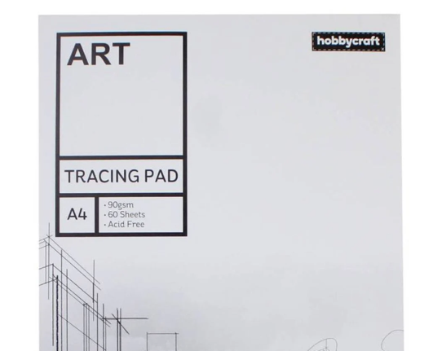
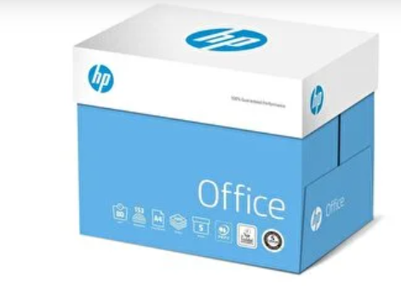
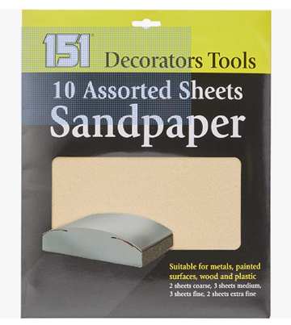
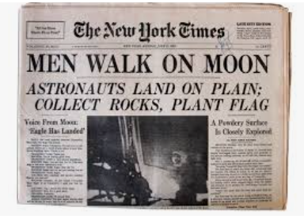

Slide 3
What do you think is the world record for the number of times a piece of paper can be folded?
How many times can you fold a piece of paper?

Slide 4
What do you predict?
Will it be the same for each type of paper?
If not, what will make the difference?

Slide 5
How will you record your predictions and your results?

Slide 6
How will you record your predictions and your results?
Type of paper | Prediction | Result

Slide 7
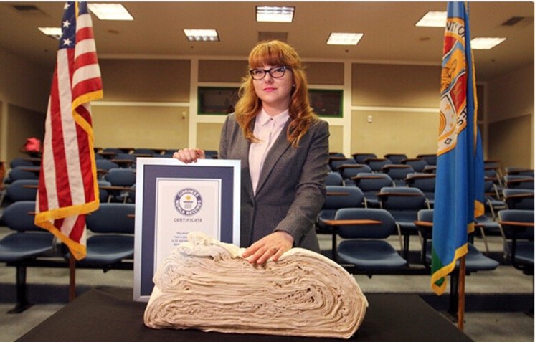
Have you changed your mind about the world record?

Slide 8
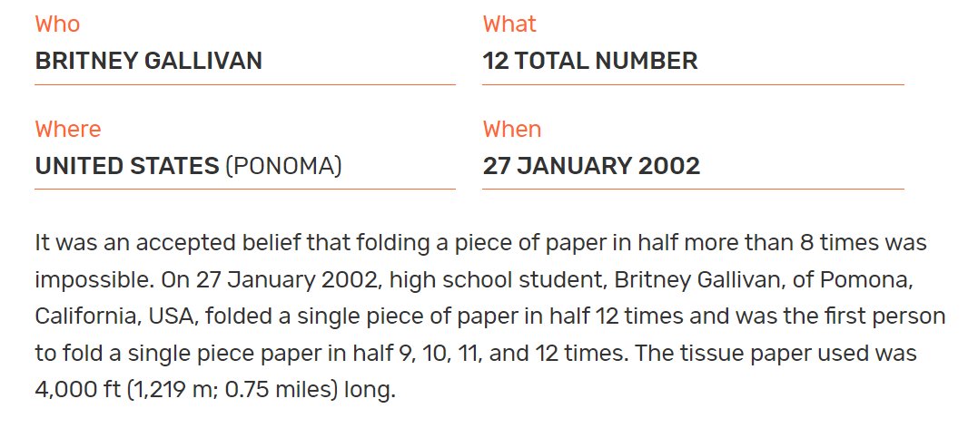

Slide 9
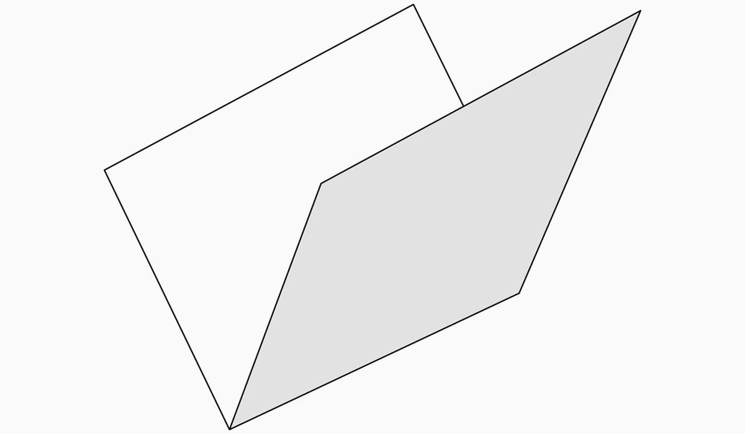
What unit of measurement would be the most sensible to measure the thickness of a regular piece of printer paper?
A sheet of regular paper is 0.1mm thick
How thick would it be if it was folded in half?

Slide 10
Number of folds | Height of the paper
None | 0.1 mm
1 fold | 0.2 mm
2 folds | 0.4 mm
3 folds | 0.8 mm
4 folds | 1.6 mm
5 folds | 3.2 mm
6 folds | 6.4 mm
7 folds | 12.8 mm

Slide 11
Number of folds | Height of the paper
None | 0.1 mm
1 fold | 0.2 mm
2 folds | 0.4 mm
3 folds | 0.8 mm
4 folds | 1.6 mm
5 folds | 3.2 mm
6 folds | 6.4 mm
7 folds | 12.8 mm

Slide 12
Number of folds | Height of the paper
None | 0.1 mm
1 fold | 0.2 mm
2 folds | 0.4 mm
3 folds | 0.8 mm
4 folds | 1.6 mm
5 folds | 3.2 mm
6 folds | 6.4 mm
7 folds | 12.8 mm

Slide 13
Number of folds | Height of the paper
None | 0.1 mm
1 fold | 0.2 mm
2 folds | 0.4 mm
3 folds | 0.8 mm
4 folds | 1.6 mm
5 folds | 3.2 mm
6 folds | 6.4 mm
7 folds | 12.8 mm

Slide 14
Number of folds | Height of the paper
None | 0.1 mm
1 fold | 0.2 mm
2 folds | 0.4 mm
3 folds | 0.8 mm
4 folds | 1.6 mm
5 folds | 3.2 mm
6 folds | 6.4 mm
7 folds | 12.8 mm

Slide 15
Number of folds | Height of the paper
None | 0.1 mm
1 fold | 0.2 mm
2 folds | 0.4 mm
3 folds | 0.8 mm
4 folds | 1.6 mm
5 folds | 3.2 mm
6 folds | 6.4 mm
7 folds | 12.8 mm

Slide 16
Number of folds | Height of the paper
None | 0.1 mm
1 fold | 0.2 mm
2 folds | 0.4 mm
3 folds | 0.8 mm
4 folds | 1.6 mm
5 folds | 3.2 mm
6 folds | 6.4 mm
7 folds | 12.8 mm
12.8 mm

Slide 17
Number of folds | Height of the paper
None | 0.1 mm
1 fold | 0.2 mm
2 folds | 0.4 mm
3 folds | 0.8 mm
4 folds | 1.6 mm
5 folds | 3.2 mm
6 folds | 6.4 mm
7 folds | 12.8 mm
1.28 cm

Slide 18
Number of folds | Height of the paper | Something a similar height
7 folds | 1.28 cm
8 folds
9 folds
10 folds
11 folds
12 folds
13 folds
14 folds
Notes:
Independent/paired activity

Slide 19
Number of folds | Height of the paper | Something a similar height
7 folds | 1.28 cm
8 folds | 2.56 cm
9 folds | 5.12 cm
10 folds | 10.24 cm
11 folds | 20.48 cm
12 folds | 40.96 cm
13 folds | 81.92 cm
14 folds | 163.84 cm
163.84 cm
Notes:
Independent/paired activity

Slide 20
Number of folds | Height of the paper | Something a similar height
7 folds | 1.28 cm
8 folds | 2.56 cm
9 folds | 5.12 cm
10 folds | 10.24 cm
11 folds | 20.48 cm
12 folds | 40.96 cm
13 folds | 81.92 cm
14 folds | 163.84 cm
1.6384 m
Notes:
Independent/paired activity

Slide 21
Number of folds | Height of the paper | Something a similar height
7 folds | 1.28 cm
8 folds | 2.56 cm
9 folds | 5.12 cm
10 folds | 10.24 cm
11 folds | 20.48 cm
12 folds | 40.96 cm
13 folds | 81.92 cm
14 folds | 163.84 cm
1.64 m
Notes:
Independent/paired activity

Slide 22
No folds is 0.1 mm high which is the height of…….
Notes:
A piece of paper

Slide 23
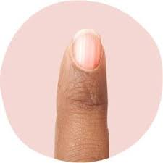
7 folds is 1.3 cm high which is approximately the height of…….
Notes:
A fingernail

Slide 24
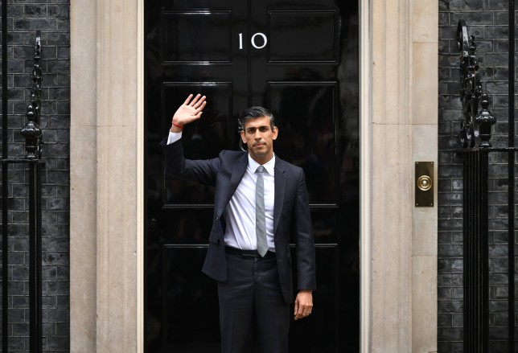
14 folds is 1.64m high which is approximately the height of…….
Notes:
Rishi Sunak is 1.7m tall

Slide 25
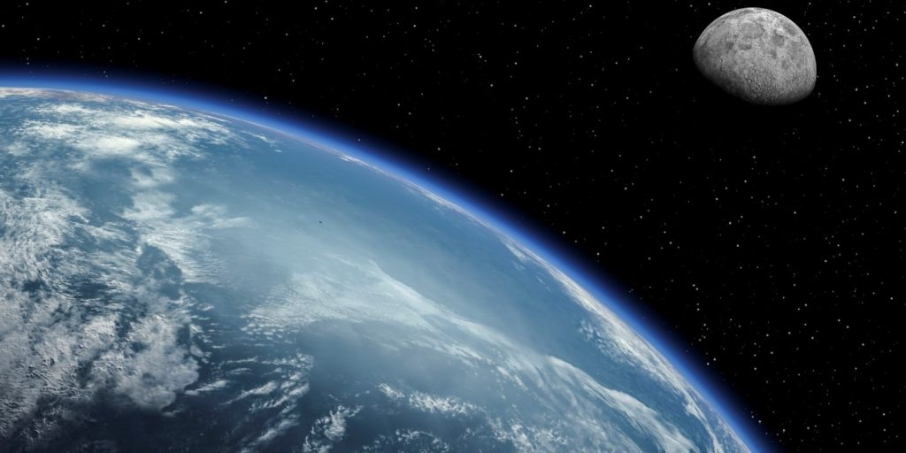
How many folds do you think it would it take so the paper is high enough to reach the moon?
Clue – the moon is 384,400 km away

Slide 26
How many folds do you think it would it take so the paper is high enough to reach the moon?
Clue – the moon is 384,400 km away

Slide 27
Number of folds | Height of the paper
None | 0.1 mm
1 fold | 0.2 mm
2 folds | 0.4 mm
3 folds | 0.8 mm
4 folds | 1.6 mm
5 folds | 3.2 mm
6 folds | 6.4 mm
7 folds | 1.28 cm
We don’t have to keep multiplying by 2
Indices can help us work out the answer!

Slide 28
Number of folds | Height of the paper
None | 0.1 mm
1 fold | 0.2 mm | 2 | 2
2 folds | 0.4 mm | 2 x 2 | $$2^{2}$$
3 folds | 0.8 mm | 2 x 2 x 2 | $$2^{3}$$
4 folds | 1.6 mm | 2 x 2 x 2 x 2 | $$2^{4}$$
5 folds | 3.2 mm | 2 x 2 x 2 x 2 x 2 | $$2^{5}$$
6 folds | 6.4 mm | 2 x 2 x 2 x 2 x 2 x 2 | $$2^{6}$$
7 folds | 1.28 cm | 2 x 2 x 2 x 2 x 2 x 2 x 2 | $$2^{7}$$

Slide 29
Number of folds | Height of the paper
None | 0.1 mm
1 fold | 0.2 mm | 2 | 2
2 folds | 0.4 mm | 2 x 2 | $$2^{2}$$
3 folds | 0.8 mm | 2 x 2 x 2 | $$2^{3}$$
4 folds | 1.6 mm | 2 x 2 x 2 x 2 | $$2^{4}$$
5 folds | 3.2 mm | 2 x 2 x 2 x 2 x 2 | $$2^{5}$$
6 folds | 6.4 mm | 2 x 2 x 2 x 2 x 2 x 2 | $$2^{6}$$
7 folds | 1.28 cm | 2 x 2 x 2 x 2 x 2 x 2 x 2 | $$2^{7}$$

Slide 30
Number of folds | Height of the paper
None | 0.1 mm
1 fold | 0.2 mm | 2 | 2
2 folds | 0.4 mm | 2 x 2 | $$2^{2}$$
3 folds | 0.8 mm | 2 x 2 x 2 | $$2^{3}$$
4 folds | 1.6 mm | 2 x 2 x 2 x 2 | $$2^{4}$$
5 folds | 3.2 mm | 2 x 2 x 2 x 2 x 2 | $$2^{5}$$
6 folds | 6.4 mm | 2 x 2 x 2 x 2 x 2 x 2 | $$2^{6}$$
7 folds | 1.28 cm | 2 x 2 x 2 x 2 x 2 x 2 x 2 | $$2^{7}$$

Slide 31
Number of folds | Height of the paper
None | 0.1 mm
1 fold | 0.2 mm | 2 | 2
2 folds | 0.4 mm | 2 x 2 | $$2^{2}$$
3 folds | 0.8 mm | 2 x 2 x 2 | $$2^{3}$$
4 folds | 1.6 mm | 2 x 2 x 2 x 2 | $$2^{4}$$
5 folds | 3.2 mm | 2 x 2 x 2 x 2 x 2 | $$2^{5}$$
6 folds | 6.4 mm | 2 x 2 x 2 x 2 x 2 x 2 | $$2^{6}$$
7 folds | 1.28 cm | 2 x 2 x 2 x 2 x 2 x 2 x 2 | $$2^{7}$$

Slide 32
Number of folds | Height of the paper
None | 0.1 mm
1 fold | 0.2 mm | 2 | 2
2 folds | 0.4 mm | 2 x 2 | $$2^{2}$$
3 folds | 0.8 mm | 2 x 2 x 2 | $$2^{3}$$
4 folds | 1.6 mm | 2 x 2 x 2 x 2 | $$2^{4}$$
5 folds | 3.2 mm | 2 x 2 x 2 x 2 x 2 | $$2^{5}$$
6 folds | 6.4 mm | 2 x 2 x 2 x 2 x 2 x 2 | $$2^{6}$$
7 folds | 1.28 cm | 2 x 2 x 2 x 2 x 2 x 2 x 2 | $$2^{7}$$

Slide 33
Number of folds | Height of the paper
None | 0.1 mm
1 fold | 0.2 mm | 2 | 2
2 folds | 0.4 mm | 2 x 2 | $$2^{2}$$
3 folds | 0.8 mm | 2 x 2 x 2 | $$2^{3}$$
4 folds | 1.6 mm | 2 x 2 x 2 x 2 | $$2^{4}$$
5 folds | 3.2 mm | 2 x 2 x 2 x 2 x 2 | $$2^{5}$$
6 folds | 6.4 mm | 2 x 2 x 2 x 2 x 2 x 2 | $$2^{6}$$
7 folds | 1.28 cm | 2 x 2 x 2 x 2 x 2 x 2 x 2 | $$2^{7}$$

Slide 34
How can we work out how high the paper would be if it was folded 20 times?
2 x 2 x 2 x 2 x 2 x 2 x 2 x 2 x 2 x 2 x 2 x 2 x 2 x 2 x 2 x 2 x 2 x 2 x 2 x 2
Or
$$2^{20}$$

Slide 35
2 x 2 x 2 x 2 x 2 x 2 x 2 x 2 x 2 x 2 x 2 x 2 x 2 x 2 x 2 x 2 x 2 x 2 x 2 x 2
$$2^{20}$$
= 1048576
= 104.86 m

Slide 36
14 folds is 1.64m high which is approximately the height of…….

Slide 37
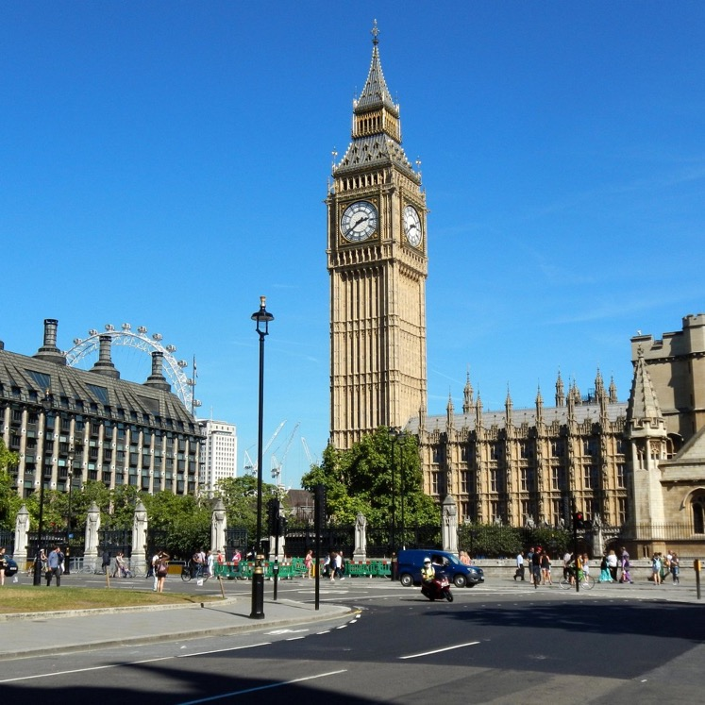
20 folds is 104.86 m high which is approximately the height of…….

Slide 38
So, how many folds do you think it would it take so the paper is high enough to reach the moon?
Reminder – the moon is 384,400 km away

Slide 39
The answer is…..
42! If you were able to fold a piece of A4 paper 42 times it would reach to the moon!
How many folds would take you to the moon and back again?

Slide 40
Would you rather have a penny that doubles everyday or a million pounds?

